Slide 1

Data Structures: Stack and Queue
Dr. Murali Krishna Enduri
Department of CSE

Slide 2
Data Structures Introduction
A data structure is a :
process of organizing the data elements in the memory of a computer(Eg: Array, stack, Queue, list, tree).
Data structure has two components :
1. Interface : function declarations
2. Implementation : Function definition for declarations.
A data structure can be……..
(a) transient
i.e. it is created when a program starts and is destroyed when the program ends. Most data structures in main memory are transient, for example, an array of data.
(b) Permanent
i.e. it already exists when a program starts and is preserved when the program ends. Most data structures on disk are permanent, for example, a file of data, or a cross-linked data file collection (a database).

Slide 3
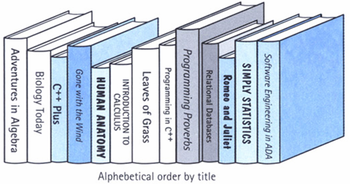
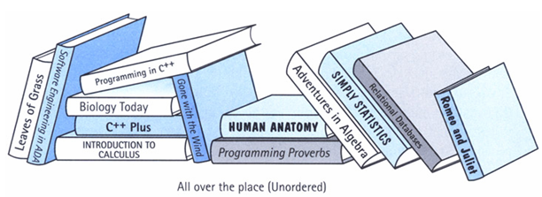
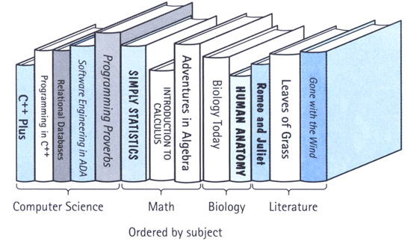
Data Structures Introduction
Example: Library management System
is composed of data elements (books).
Organizing the data (Data Structure)
Accessing a particular (data element)book requires knowledge of the arrangement of the books.
ordered Data structure (Array)
Unordered Data structure

Slide 4
What is this Course About?
Clever way to organize the information in order to enable efficient computation (Time and space complexity)
What do we mean by clever?
What do we mean by efficient?
Clever? Efficient?
Lists, Stacks, Queues
Linked List
Heaps
Binary Search Trees
AVL Trees
Hash Tables
Graphs
Disjoint Sets
Sorting Algorithm
Searching Algorithm
Traversal algorithms
Tree traversal algorithms
Algorithms
Data Structures

Slide 5
Data Structures Introduction
C: Structures Introduction
We need to understand the concept of Information and how it is organized or how it can be utilized.
If we arrange some data in an appropriate sequence, then it forms a Structure and gives us a meaning. This meaning is called Information .
The basic unit of Information in Computer Science is a bit, Binary Digit .
So, we need to know about two things in Information: One is Data and the other is Structure.
A data structure is a systematic way of organizing and accessing data.
A data structure tries to structure data!
Usually more than one piece of data
Should define legal operations on the data
The data might be grouped together (e.g. in an linked list)

Slide 6
Types of Data structure
Data Structure
Linear
Non-Linear
Array
Stack
Queue
Linked Lists
Trees
Graphs

Slide 7
Linear Data Structures Introduction
A data structure is said to be linear if its elements form a sequence or a linear list.
Examples:
Array
Stacks
Queues
Linked List
Operations on linear Data Structures
Traversal : Visit every part of the data structure
Search : Traversal through the data structure for a given element
Insertion : Adding new elements to the data structure
Deletion : Removing an element from the data structure.
Sorting : Rearranging the elements in some type of order(e.g Increasing or Decreasing)
Merging : Combining two similar data structures into one

Slide 8
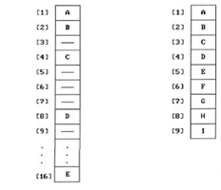
Array
1.Array :
An array is a collection of homogeneous type of data elements.
2. Array Interfaces / Functionalities of Array
Traversing
Search
Insertion
Deletion
Sorting
Merging

Slide 9
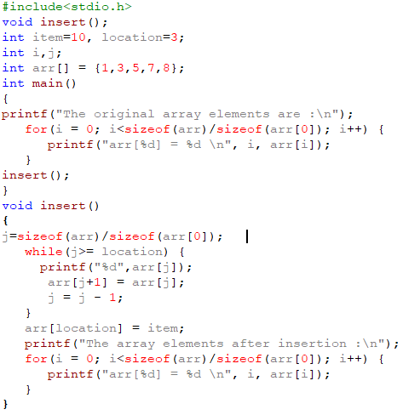
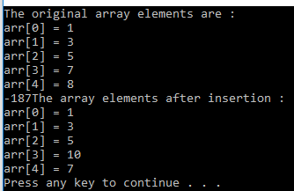
Inserting the data element into an Array

Slide 10
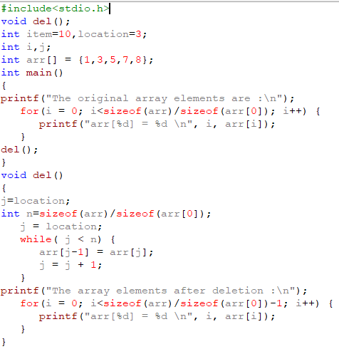
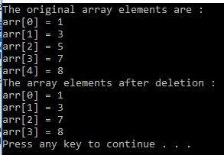
Deleting the data element from an array

Slide 11
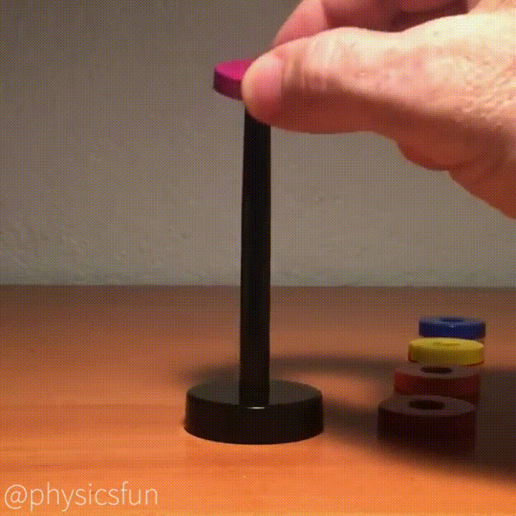
Stack Introduction
Stack is basically a data object .
A stack is a data structure in which items can be inserted only from one end and get items back from the same end.
There , the last item inserted into stack, is the first item to be taken out from the stack.
In short its also called Last in First out [LIFO]. (The last element inserted will be the first to be retrieved)

Slide 12
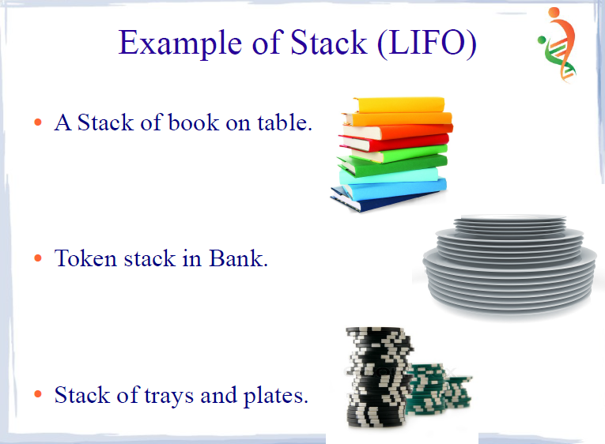
Practical daily life : a pile of heavy books kept in a vertical box,dishes kept one on top of another
In computer world : In processing of subroutine calls and returns ; there is an explicit use of stack of return addresses.
Also in evaluation of arithmetic expressions , stack is used.

Slide 13
Operations on Stack
Primary operations defined on a stack:
PUSH : add an element at the top of the list.
POP : remove the at the top of the list.
Also "IsEmpty()" and IsFull" function, which tests whether a stack is empty or full respectively.
Implementations of stacks using
array
linked list

Slide 14
Push and Pop
Primary operations: Push and Pop
Push
Add an element to the top of the stack
Pop
Remove the element at the top of the stack
"IsEmpty()" and IsFull" functions
empty stack
push an element
push another
pop
push another
Stack full
top
C
top
top
A
B
C
top
top
C
top
A
A
A
A
A

Slide 15
Implementation of stack using array
Need to declare an array size ahead of time
Associated with each stack is TopOfStack
for an empty stack, set TopOfStack to -1
Push
(1) Increment TopOfStack by 1.
(2) Set Stack[TopOfStack] = X
Pop
(1) Set return value to Stack[TopOfStack]
(2) Decrement TopOfStack by 1
Any time TopofStack is equal to size of array then stack is full.
These operations are performed in constant time

Slide 16
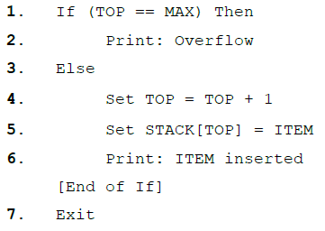
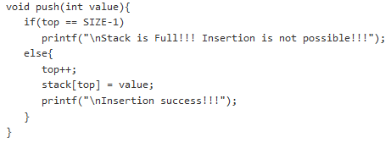
Implementation of stack using array
Push ( ):
Description: Here STACK is an array with MAX locations. TOP points to the top most element and ITEM is the value to be inserted.

Slide 17
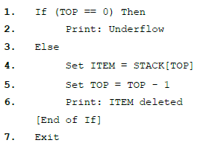
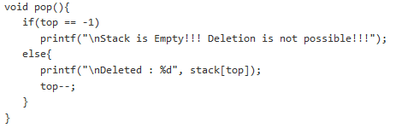
Implementation of stack using array
Pop ( ):
Description: Here STACK is an array with MAX locations. TOP points to the top most element.

Slide 18
#include<stdio.h>
#define SIZE 10
void push(int);
void pop();
void display();
int stack[SIZE], top = -1;
void main()
{
int value, choice;
while(1){
printf("\n\n***** MENU *****\n");
printf("1. Push\n2. Pop\n3. Display\n4. Exit");
printf("\nEnter your choice: ");
scanf("%d",&choice);
switch(choice){
case 1: printf("Enter the value to be insert: ");
scanf("%d",&value);
push(value);
break;
case 2: pop();
break;
case 3: display();
break;
case 4: exit(0);
default: printf("\nWrong selection!!! Try again!!!");
}
}
}
void push(int value){
if(top == SIZE-1)
printf("\nStack is Full!!! Insertion is not possible!!!");
else{
top++;
stack[top] = value;
printf("\nInsertion success!!!");
}
}
void pop(){
if(top == -1)
printf("\nStack is Empty!!! Deletion is not possible!!!");
else{
printf("\nDeleted : %d", stack[top]);
top--;
}
}
void display(){
if(top == -1)
printf("\nStack is Empty!!!");
else{
int i;
printf("\nStack elements are:\n");
for(i=top; i>=0; i--)
printf("%d\n",stack[i]);
}
}

Slide 19
#include<stdio.h>
#define SIZE 10
void push(int);
void pop();
void display();
int stack[SIZE], top = -1;
void main()
{
int value, choice;
while(1){
printf("\n\n***** MENU *****\n");
printf("1. Push\n2. Pop\n3. Peek \n 4. Display 5. Exit");
printf("\nEnter your choice: ");
scanf("%d",&choice);
switch(choice){
case 1: printf("Enter the value to be insert: ");
scanf("%d",&value);
push(value);
break;
case 2: pop();
break;
case 3: peek();
break;
case 4: display();
break;
case 5: exit(0);
default: printf("\nWrong selection!!! Try again!!!");
}
}
}
Peek() is one of a stack operation that prints the value of the top most element of the stack without deleting that element from the stack.
void peek(){
if(top == -1)
printf("\nStack is Empty!!!");
else{
int i;
printf("\nStack top most element is: %d\n“,stack[top]);
}
}

Slide 20
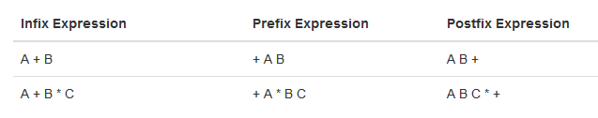
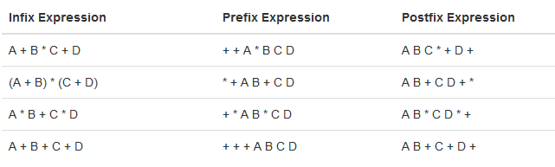
Application of stack
A * B + C * D
(A + (B * C))
2. To check that every right brace, bracket, and parentheses must correspond to its left counterpart
e.g. [( )] is legal, but [( ] ) is illegal

Slide 21
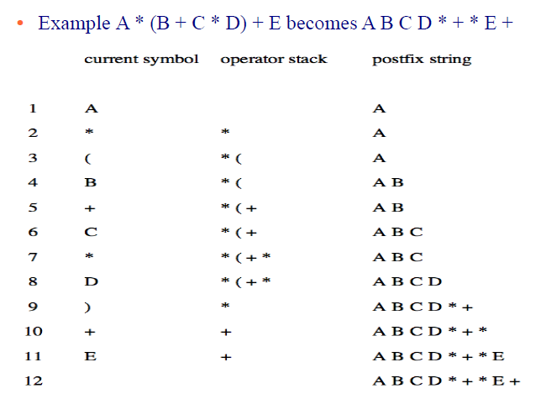
Application of stack
Infix to Postfix using stack ...

Slide 22
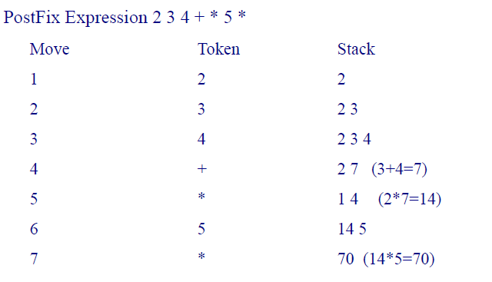
Application of stack
Evaluating Arithmetic Postfix Expression

Slide 23
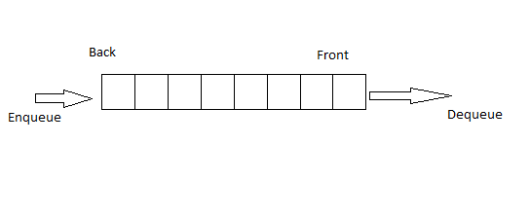
Queue Introduction
Like a stack, a queue is also a list. However, with a queue, insertion is done at one end, while deletion is performed at the other end.
Accessing the elements of queues follows a First In, First Out (FIFO) order.
Like customers standing in a check-out line in a store, the first customer in is the first customer served.
Example :
PRACTICAL EXAMPLE : A line at a ticket counter for buying tickets operates on above rules.
2. IN COMPUTER WORLD : In a batch processing system, jobs are queued up for processing.

Slide 24
Operations on Queue
Primary operations defined on a Queue:
EnQueue : This is used to add elements into the queue at the back end.
DeQueue : This is used to delete elements from a queue from the front end.
Also "IsEmpty()" and "IsFull()" can be defined to test whether the queue is Empty or full.
Implementations of stacks using
array
linked list
Remove (Dequeue)
Insert (Enqueue)
front
rear

Slide 25
Queue Implementation using array
There are several different algorithms to implement Enqueue and Dequeue
When enqueuing, the front index is always fixed and the rear index moves forward in the array.
rear
rear
rear
rear
rear
3
3
6
3
6
9
6
9
9
front
front
front
front
front
Enqueue(3)
Enqueue(6)
Enqueue(9)
Dequeue()
Dequeue()
rear = -1
front=-1

Slide 26
Queue Implementation using array
Insert ( ): or EnQueue():
Description: Here QUEUE is an array with N locations. FRONT and REAR points to the front and rear of the QUEUE. ITEM is the value to be inserted.
void enQueue(int value){
if(rear == SIZE-1)
printf("\nQueue is Full!!! Insertion is not possible!!!");
else{
if(front == -1)
front = 0;
rear++;
queue[rear] = value;
printf("\nInsertion success!!!");
}
}

Slide 27
Queue Implementation using array
Delete ( ): or DeQueue():
Description: Here QUEUE is an array with N locations. FRONT and REAR points to the front and rear of the QUEUE.
void deQueue(){
if(front == rear)
printf("\nQueue is Empty!!! Deletion is not possible!!!");
else{
printf("\nDeleted : %d", queue[front]);
front++;
if(front == rear)
front = rear = -1;
}
}

Slide 28
#include<stdio.h>
#define SIZE 10
void enQueue(int);
void deQueue();
void display();
int queue[10], front = -1, rear = -1;
void main() {
int value, choice;
while(1){
printf("\n\n***** MENU *****\n");
printf("1. Insertion\n2. Deletion\n3. Display\n4. Exit");
printf("\nEnter your choice: ");
scanf("%d",&choice);
switch(choice){
case 1: printf("Enter the value to be insert: ");
scanf("%d",&value);
enQueue(value);
break;
case 2: deQueue();
break;
case 3: display();
break;
case 4: exit(0);
default: printf("\nWrong selection!!! Try again!!!");
}
}}
void enQueue(int value){
if(rear == SIZE-1)
printf("\nQueue is Full!!! Insertion is not possible!!!");
else{
if(front == -1)
front = 0;
rear++;
queue[rear] = value;
printf("\nInsertion success!!!");
}}
void deQueue(){
if(front == rear)
printf("\nQueue is Empty!!! Deletion is not possible!!!");
else{
printf("\nDeleted : %d", queue[front]);
front++;
if(front == rear)
front = rear = -1;
}}
void display(){
if(rear == -1)
printf("\nQueue is Empty!!!");
else{
int i;
printf("\nQueue elements are:\n");
for(i=front; i<=rear; i++)
printf("%d\t",queue[i]);
}}

Slide 29
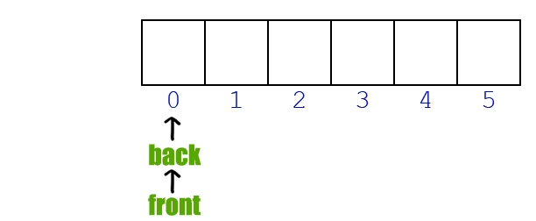
Queue Implementation using circular array

Slide 30
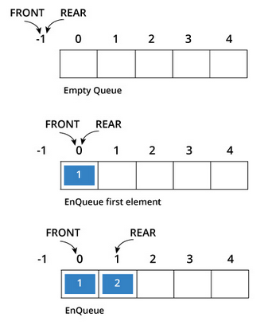
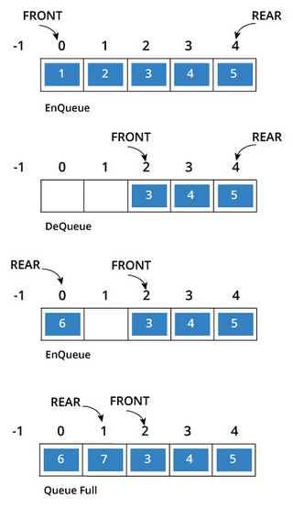
Queue Implementation using circular array

Slide 31
#include<stdio.h>
#define SIZE 10
void enQueue(int);
void deQueue();
void display();
int queue[10], front = -1, rear = -1;
void main() {
int value, choice;
while(1){
printf("\n\n***** MENU *****\n");
printf("1. Insertion\n2. Deletion\n3. Display\n4. Exit");
printf("\nEnter your choice: ");
scanf("%d",&choice);
switch(choice){
case 1: printf("Enter the value to be insert: ");
scanf("%d",&value);
enQueue(value);
break;
case 2: deQueue();
break;
case 3: display();
break;
case 4: exit(0);
default: printf("\nWrong selection!!! Try again!!!");
}
}}
void enQueue(int value){
if((front==0 &&rear == SIZE-1) || front==rear+1)
printf("\nQueue is Full!!! Insertion is not possible!!!");
else{
if(front == -1)
front = 0;
rear=(rear+1)%SIZE;
queue[rear] = value;
printf("\nInsertion success!!!");
}}
void deQueue(){
if(front == -1)
printf("\nQueue is Empty!!! Deletion is not possible!!!");
else{
printf("\nDeleted : %d", queue[front]);
front=(front+1)%SIZE;
if(front == rear)
front = rear = -1;
}}
void display(){
if(front == -1)
printf("\nQueue is Empty!!!");
else{
int i;
printf("\nQueue elements are:\n");
for(i=front; i!=rear; i=(i+1)%SIZE)
printf("%d\t",queue[i]);
}}

Slide 32
Application of Queue
Queue is used when things don’t have to be processed immediately, but have to be processed in First In First Out order. This property of Queue makes it also useful in following kind of scenarios.
1) When a resource is shared among multiple consumers. Examples include CPU scheduling, Disk Scheduling.
2) When data is transferred asynchronously (data not necessarily received at same rate as sent) between two processes. Examples include IO Buffers, pipes, file IO, etc.

Slide 33
Problems on Stack and Queue
1. Implement the stack using Array in C.
Reverse a string by using stack in C.
Converting infix expression to postfix (or prefix) expression using stack. (Example
input: A * B + C * D and output: AB*CD*+)
Evaluation of arithmetic expression using stack. (Example input: (2+4)*(4+6) and output: 60 )
Implement the queue using Array in C.

